Slide 1

Bispectrum and Recurrent Neural Networks :
Improved Classification of Interictal and Preictal States
LEE.YEONSU
2019.11.15

Slide 2

Index
3D-CNN code modulation
Paper review
Bispectrum and Recurrent Neural Networks: Improved Classification of Interictal and Preictal States

Slide 3
Current status
Materials and Method
Bispectral feature extraction
Database
Bispectrum analysis
Higher-order spectral features
Seizure prediction algorithm
Recurrent neural network architecture
LSTM training and data splitting
Classification performance evaluation
Results and Discussion Subject-Specific EEG classification results
Conclusion

Slide 4
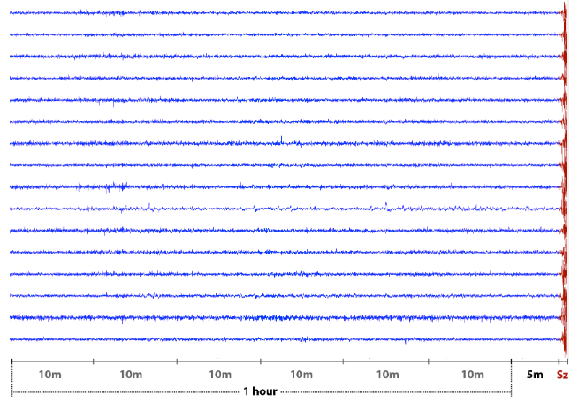
Bispectral feature extraction
Dataset
Canine iEEG (up to 1 year records per dog)
Total 45 pre-ictal hours
Dog 1 & Dog2 => 17 pre-ictal hours, respectively
Dog3 => 11 pre-ictal hours
Inter-ictal = at least 4hours before or after a seizure
Data balance
Num of pre-ictal segments =
Num of inter-ictal segments
Pre-ictal

Slide 5
Bispectral feature extraction
Preprocessing
Subject 1
Subject 2
Subject 3
Subject 4
Subject 5
Subject 6

Slide 6


Preprocessing
Preprocessing
Bispectrum Analysis
HOS Feature
Extraction
Band-Pass(0.5-180Hz) +
Notch Filtering
(60Hz)
Spectral Domain Transformation
Normalized
Entropy : $E_{1}$
Raw iEEG
16 channels 40Hz
Segmentation
Normalized
Squared
Entropy : $E_{2}$
2D Bispectrum
Plot
Data
Standardization
Data Splitting
Testing : 30%
Validation : 30%
Training : 40%

Slide 7
Bispectral feature extraction
Model
Subject 1
Subject 2
Subject 3
Subject 4
Subject 5
Subject 6

